Slide 1
Introduction to Quantum Algorithms
CS.49900 (Spring 2026)
Multi-qubit gates, Unitaries for classical circuits, Deutsch’s algorithm +Hidden matching problem and application

Slide 2














n-qubit Unitary matrix
A $n$-qubit gate (unitary circuit) $U$ is represented by $2^{n}×2^{n}$ matrix:
The inverse of $U$ is its Hermitian conjugate $U^{∗}$, i.e., $U^{∗}U=UU^{∗}=I$
or $U=\sum_{x∈{\left\{0,1\right\}}^{n}}{\left|φ_{x}\right\rangle \left\langle x\right|}$ where $\left|φ_{x}\right\rangle$ form an orthonormal basis
The other property holds similarly as in 1-qubit gate
$$U$$
$$\left|x_{1}\right\rangle$$
$$\left|x_{1}\right\rangle$$
$$\left|x_{2}\right\rangle$$
$$\left|x_{2}\right\rangle$$
$$\left|x_{3}\right\rangle$$
$$U$$
$$\left|x_{3}\right\rangle$$
$$=?$$
…
…
…
…
$$\left|x_{n−1}\right\rangle$$
$$\left|x_{n−1}\right\rangle$$
$$\left|x_{n}\right\rangle$$
$$\left|x_{n}\right\rangle$$

Slide 3

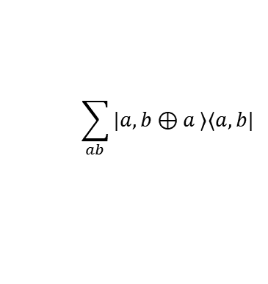










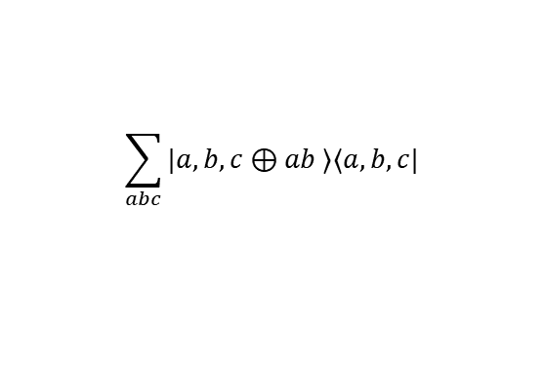
Multiple qubit gates
Recall the representation of unitary is given by
$$U=\sum_{x∈{\left\{0,1\right\}}^{n}}{\left|φ_{x}\right\rangle \left\langle x\right|}$$
A unitary $U$ is perfectly described by the basis $U:\left|x\right\rangle →|φ_{x}⟩$
Classical 2-(qu)bit gates: CNOT, CCNOT, … ( ket-bra notation on board )
CNOT gate
CCNOT gate
$$\left|a\right\rangle$$
$$\left|a\right\rangle$$
$$\left|a\right\rangle$$
$$\left|a\right\rangle$$
$$\left|b\right\rangle$$
$$\left|b⊕a\right\rangle$$
$$\left|b\right\rangle$$
$$\left|b\right\rangle$$
$$\left|c\right\rangle$$
$$\left|c⊕ab\right\rangle$$
$$\sum_{ab}{|a,b⊕a ⟩⟨a,b|}$$
$$\sum_{abc}{|a,b,c⊕ab ⟩⟨a,b,c|}$$

Slide 4












Computing classical circuits
(Theorem) Any classical circuit can be efficiently compiled into a quantum circuit of similar size
Proof sketch: Any classical circuit = circuit only using NAND gates
$$\left|a,b,NAND\left(a,b\right)\right\rangle =\left(I⊗I⊗X\right)\left|a,b,AND\left(a,b\right)\right\rangle =\left(I⊗I⊗X\right)⋅CCNOT \left|a,b,0\right\rangle$$
For each NAND gate on input a,b, we do:
$$\left|a\right\rangle$$
$$\left|a\right\rangle$$
$$\left|a\right\rangle$$
$$\left|b\right\rangle$$
$$\left|b\right\rangle$$
$$\left|NAND(a,b)\right\rangle$$
$$\left|b\right\rangle$$
$$\left|0\right\rangle$$
$$X$$
$$\left|NAND(a,b)\right\rangle$$

Slide 5





Computing classical circuits
(Theorem) Any classical circuit can be efficiently compiled into a quantum circuit of similar size
(Corollary) For any classical circuit $C:{\left\{0,1\right\}}^{n}→{\left\{0,1\right\}}^{m}$, there is a similar-size unitary circuit for
$$U_{C}:\left|x,y \right\rangle →|x,y⊕C\left(x\right)⟩$$
for any $x∈{\left\{0,1\right\}}^{n},y∈{\left\{0,1\right\}}^{m}$
$$\left|x\right\rangle$$
$$U_{C}$$
$$\left|x\right\rangle$$
…
$$\left|z\right\rangle$$
$$\left|z⊕C(x)\right\rangle$$
(Corollary) $BQP$ includes $P$ (though we did not define $BQP$ yet)

Slide 6







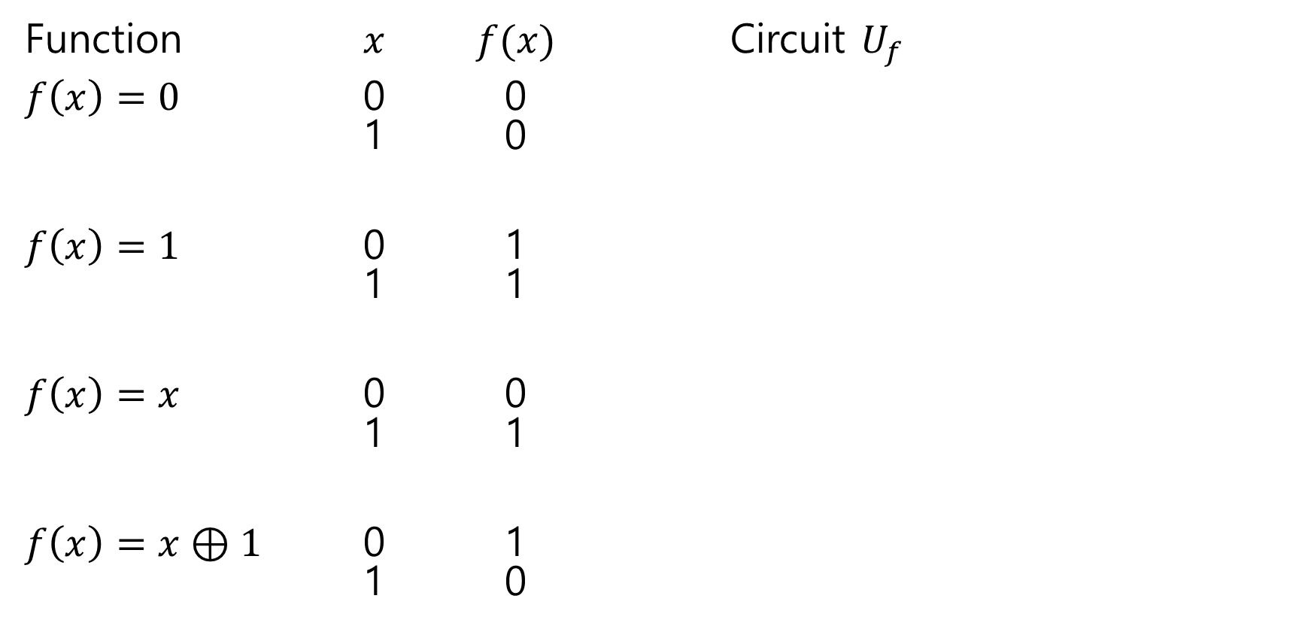











Four different single-(qu)bit functions
Function $x$ $f(x)$ Circuit $U_{f}$
$f\left(x\right)=0$ 0 0 1 0
$f\left(x\right)=1$ 0 1 1 1
$f\left(x\right)=x$ 0 0 1 1
$f\left(x\right)=x⊕1$ 0 1 1 0
$$\left|x\right\rangle$$
$$\left|x\right\rangle$$
$$\left|y\right\rangle$$
$$\left|y⊕f(x)\right\rangle$$
$$\left|x\right\rangle$$
$$\left|x\right\rangle$$
$$\left|y\right\rangle$$
$$X$$
$$\left|y⊕f(x)\right\rangle$$
$$\left|x\right\rangle$$
$$\left|x\right\rangle$$
$$\left|y\right\rangle$$
$$\left|y⊕f(x)\right\rangle$$
$$\left|x\right\rangle$$
$$\left|x\right\rangle$$
$$\left|y\right\rangle$$
$$X$$
$$\left|y⊕f(x)\right\rangle$$

Slide 7
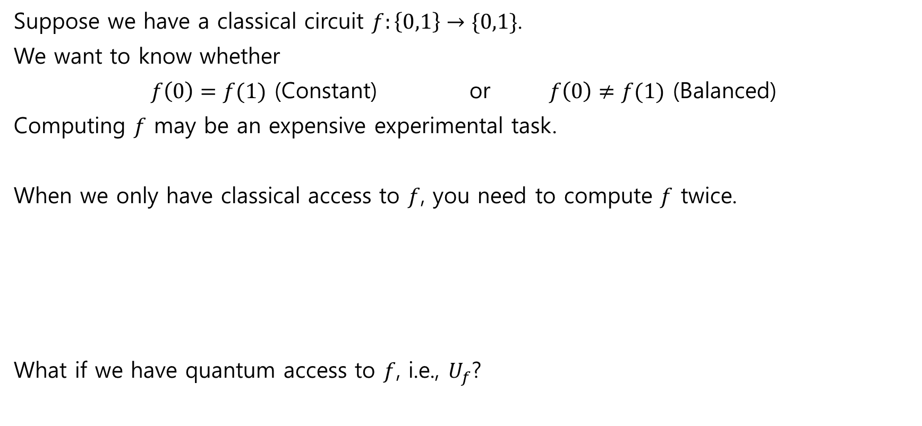
Deutsch’s algorithm
Suppose we have a classical circuit $f:\left\{0,1\right\}→\{0,1\}$.
We want to know whether
$f\left(0\right)=f(1)$ (Constant) or $f\left(0\right)≠f(1)$ (Balanced)
Computing $f$ may be an expensive experimental task.
When we only have classical access to $f$, you need to compute $f$ twice.
What if we have quantum access to $f$, i.e., $U_{f}$?

Slide 8








Deutsch’s algorithm
Prepare $|01⟩$
Apply $H⊗H$
Apply the unitary circuit $U_{f}$
Apply $H$ on the first qubit
Measure the first qubit
$$\left|0\right\rangle$$
$$H$$
$$U_{f}$$
$$H$$
$$\left|1\right\rangle$$
$$H$$

Slide 9











Deutsch’s algorithm analysis
$$U_{f}$$
$$\left|ψ_{1}\right\rangle =\left|+\right\rangle \left|−\right\rangle =\left(\frac{\left|0\right\rangle +|1⟩}{\sqrt{2}}\right)\left(\frac{\left|0\right\rangle −|1⟩}{\sqrt{2}}\right)=\frac{1}{2}\left(\left|00\right\rangle −\left|01\right\rangle +\left|10\right\rangle −|11⟩\right)$$
$f\left(x\right)=0$
$$\left|φ_{2}\right\rangle =\frac{1}{2}\left(\left|00\right\rangle −\left|01\right\rangle +\left|10\right\rangle −|11⟩\right)$$
$$=\left(\frac{\left|0\right\rangle +|1⟩}{\sqrt{2}}\right)\left(\frac{\left|0\right\rangle −|1⟩}{\sqrt{2}}\right)=\left|+\right\rangle |−⟩$$
$f\left(x\right)=1$ $\left|φ_{2}\right\rangle =\frac{1}{2}\left(\left|01\right\rangle −\left|00\right\rangle +\left|11\right\rangle −|10⟩\right)=−\left(\frac{\left|0\right\rangle +\left|1\right\rangle }{\sqrt{2}}\right)\left(\frac{\left|0\right\rangle −\left|1\right\rangle }{\sqrt{2}}\right)=−|+⟩|−⟩$
$$\left|0\right\rangle$$
$$H$$
$$H$$
$$\left|1\right\rangle$$
$$H$$
$$\left|ψ_{1}\right\rangle$$
$$\left|ψ_{1}\right\rangle$$
$$\left|ψ_{2}\right\rangle$$
$$\left|ψ_{3}\right\rangle$$

Slide 10
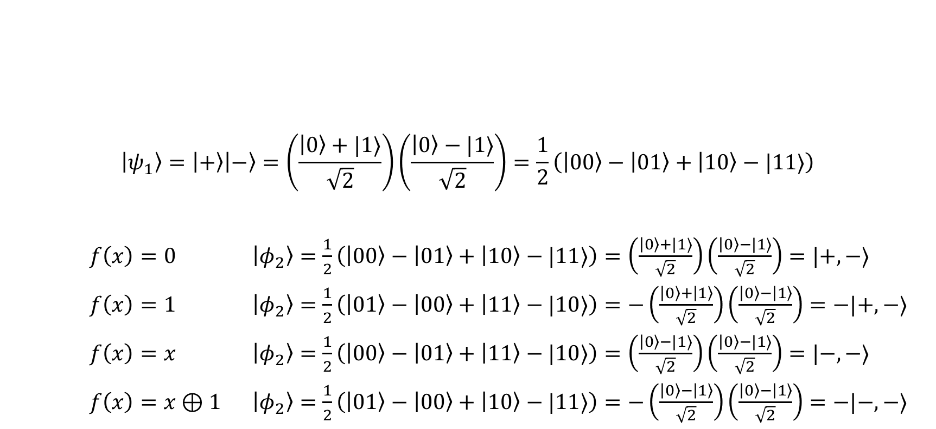
Deutsch’s algorithm analysis
$$U_{f}$$
$$\left|ψ_{1}\right\rangle =\left|+\right\rangle \left|−\right\rangle =\left(\frac{\left|0\right\rangle +|1⟩}{\sqrt{2}}\right)\left(\frac{\left|0\right\rangle −|1⟩}{\sqrt{2}}\right)=\frac{1}{2}\left(\left|00\right\rangle −\left|01\right\rangle +\left|10\right\rangle −|11⟩\right)$$
$f\left(x\right)=0$ $\left|φ_{2}\right\rangle =\frac{1}{2}\left(\left|00\right\rangle −\left|01\right\rangle +\left|10\right\rangle −|11⟩\right)=\left(\frac{\left|0\right\rangle +|1⟩}{\sqrt{2}}\right)\left(\frac{\left|0\right\rangle −|1⟩}{\sqrt{2}}\right)=|+,−⟩$
$f\left(x\right)=1$ $\left|φ_{2}\right\rangle =\frac{1}{2}\left(\left|01\right\rangle −\left|00\right\rangle +\left|11\right\rangle −|10⟩\right)=−\left(\frac{\left|0\right\rangle +\left|1\right\rangle }{\sqrt{2}}\right)\left(\frac{\left|0\right\rangle −\left|1\right\rangle }{\sqrt{2}}\right)=−|+,−⟩$
$f\left(x\right)=x$ $\left|φ_{2}\right\rangle =\frac{1}{2}\left(\left|00\right\rangle −\left|01\right\rangle +\left|11\right\rangle −|10⟩\right)=\left(\frac{\left|0\right\rangle −|1⟩}{\sqrt{2}}\right)\left(\frac{\left|0\right\rangle −|1⟩}{\sqrt{2}}\right)=|−,−⟩$
$f\left(x\right)=x⊕1$ $\left|φ_{2}\right\rangle =\frac{1}{2}\left(\left|01\right\rangle −\left|00\right\rangle +\left|10\right\rangle −|11⟩\right)=−\left(\frac{\left|0\right\rangle −\left|1\right\rangle }{\sqrt{2}}\right)\left(\frac{\left|0\right\rangle −\left|1\right\rangle }{\sqrt{2}}\right)=−|−,−⟩$
$$\left|0\right\rangle$$
$$H$$
$$H$$
$$\left|1\right\rangle$$
$$H$$
$$\left|ψ_{1}\right\rangle$$
$$\left|ψ_{1}\right\rangle$$
$$\left|ψ_{2}\right\rangle$$
$$\left|ψ_{3}\right\rangle$$

Slide 11

Deutsch’s algorithm analysis
$$U_{f}$$
$\left|φ_{2}\right\rangle =±\left(\frac{\left|0\right\rangle +|1⟩}{\sqrt{2}}\right)\left(\frac{\left|0\right\rangle −|1⟩}{\sqrt{2}}\right)$ if $f\left(0\right)=f(1)$
$\left|φ_{2}\right\rangle =±\left(\frac{\left|0\right\rangle −|1⟩}{\sqrt{2}}\right)\left(\frac{\left|0\right\rangle −|1⟩}{\sqrt{2}}\right)$ if $f\left(0\right)≠f(1)$
Applying Hadamard, we have
$\left|φ_{3}\right\rangle =±|0⟩\left(\frac{\left|0\right\rangle −|1⟩}{\sqrt{2}}\right)$ if $f\left(0\right)=f(1)$
$\left|φ_{3}\right\rangle =±|1⟩\left(\frac{\left|0\right\rangle −|1⟩}{\sqrt{2}}\right)$ if $f\left(0\right)≠f(1)$
$$\left|0\right\rangle$$
$$H$$
$$H$$
$$\left|1\right\rangle$$
$$H$$
$$\left|ψ_{1}\right\rangle$$
$$\left|ψ_{1}\right\rangle$$
$$\left|ψ_{2}\right\rangle$$
$$\left|ψ_{3}\right\rangle$$

Slide 12

Deutsch’s algorithm analysis
$$U_{f}$$
The final outcome is 0 if $f\left(0\right)=f(1)$ and 1 if $f\left(0\right)≠f(1)$
(One-shot analysis on board)
$$\left|0\right\rangle$$
$$H$$
$$H$$
$$\left|1\right\rangle$$
$$H$$
$$\left|ψ_{1}\right\rangle$$
$$\left|ψ_{1}\right\rangle$$
$$\left|ψ_{2}\right\rangle$$
$$\left|ψ_{3}\right\rangle$$

Slide 13












Two unitaries for classical circuits
For any binary-output circuit $C:{\left\{0,1\right\}}^{n}→\left\{0,1\right\}$, we just show how to implement
$U_{C}:\left|x,z\right\rangle →|x,z⊕C\left(x\right)⟩$, i.e., $U_{C}=\sum_{x,z}{\left|x,z⊕C\left(x\right)\right\rangle \left\langle x,z\right|}$
Consider the “phase” implementation of $C$
$$P_{C}:\left|x\right\rangle →{\left(−1\right)}^{C(x)}|x⟩$$
$$\left|x\right\rangle$$
$$U_{C}$$
$$\left|x\right\rangle$$
$$\left|x\right\rangle$$
$$U_{C}$$
$${\left(−1\right)}^{C(x)}\left|x\right\rangle$$
…
$$\left|z\right\rangle$$
$$\left|z⊕C(x)\right\rangle$$
$$\left|1\right\rangle$$
$$H$$
$$\left|−\right\rangle$$

Slide 14





Deutsch’s algorithm by phase circuit
Prepare the following 1-qubit state $\left|+\right\rangle =\frac{1}{\sqrt{2}}\sum_{x∈\{0,1\}}{|x⟩}$
Apply the phase circuit $P_{C}$ $P_{C}\left|+\right\rangle =\frac{1}{\sqrt{2}}\sum_{x∈\{0,1\}}{P_{C}|x⟩}=\frac{1}{\sqrt{2}}\sum_{x∈\{0,1\}}{{\left(−1\right)}^{C(x)}|x⟩}$
Measure the state under $\left|+\right\rangle ,\left|−\right\rangle$.
Analysis on board.
$$\left|0\right\rangle$$
$$H$$
$$P_{f}$$
$$H$$

Slide 15
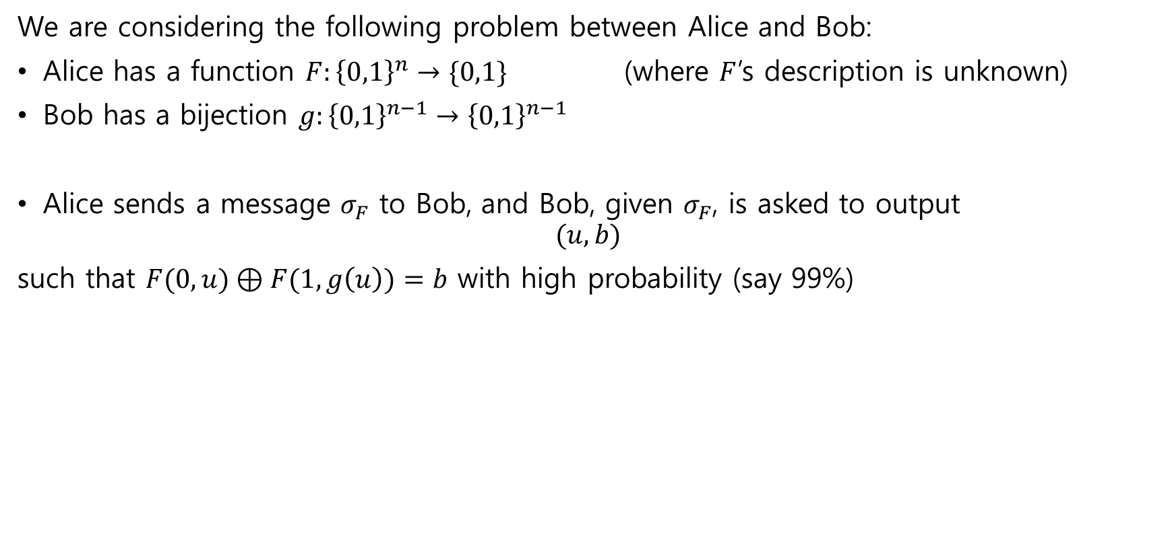
Hidden matching problem
Slightly advanced
We are considering the following problem between Alice and Bob:
Alice has a function $F:{\left\{0,1\right\}}^{n}→\{0,1\}$ (where $F$’s description is unknown)
Bob has a bijection $g:{\left\{0,1\right\}}^{n−1}→{\left\{0,1\right\}}^{n−1}$
Alice sends a message $σ_{F}$ to Bob, and Bob, given $σ_{F}$, is asked to output
$$(u,b)$$
such that $F(0,u)⊕F(1,g\left(u\right))=b$ with high probability (say 99%)

Slide 16
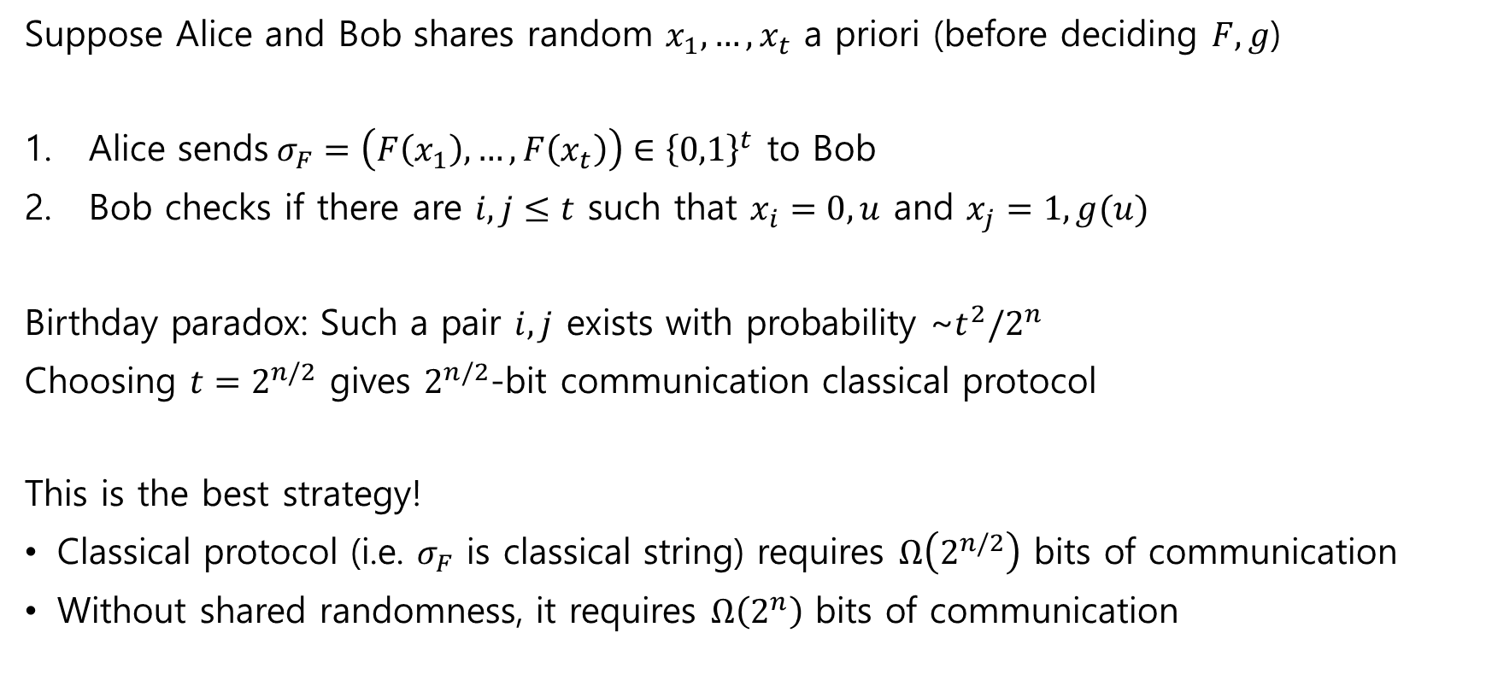
Hidden matching problem Classical strategy
Slightly advanced
Suppose Alice and Bob shares random $x_{1},…,x_{t}$ a priori (before deciding $F,g$)
Alice sends$σ_{F}=\left(F\left(x_{1}\right),…,F\left(x_{t}\right)\right)∈{\left\{0,1\right\}}^{t}$ to Bob
Bob checks if there are $i,j≤t$ such that $x_{i}=0,u$ and $x_{j}=1,g(u)$
Birthday paradox: Such a pair $i,j$ exists with probability ~$t^{2}/2^{n}$
Choosing $t=2^{n/2}$ gives $2^{n/2}$-bit communication classical protocol
This is the best strategy!
Classical protocol (i.e. $σ_{F}$ is classical string) requires $Ω\left(2^{n/2}\right)$ bits of communication
Without shared randomness, it requires $Ω\left(2^{n}\right)$ bits of communication

Slide 17
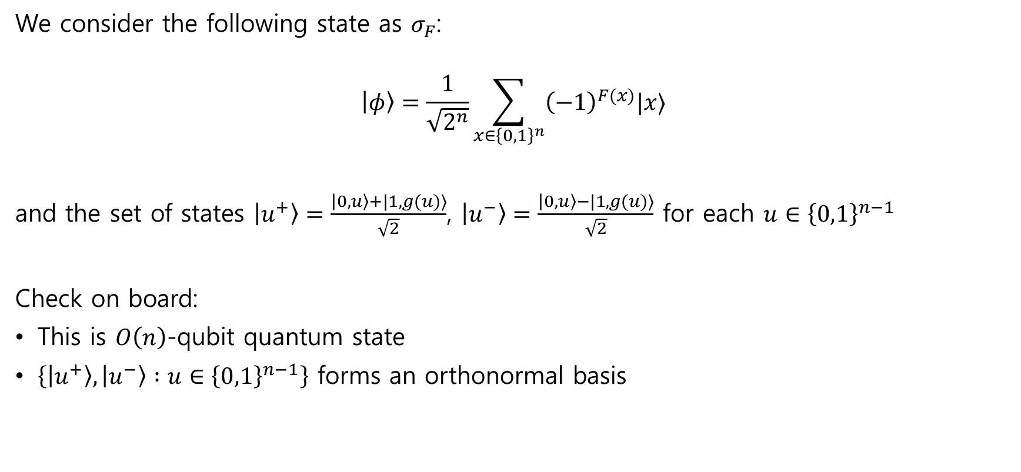
Hidden matching problem Quantum strategy
Slightly advanced
We consider the following state as $σ_{F}$:
$$\left|φ\right\rangle =\frac{1}{\sqrt{2^{n}}}\sum_{x∈{\left\{0,1\right\}}^{n}}{{\left(−1\right)}^{F(x)}|x⟩}$$
and the set of states $\left|u^{+}\right\rangle =\frac{\left|0,u\right\rangle +|1,g(u)⟩}{\sqrt{2}}$, $\left|u^{−}\right\rangle =\frac{\left|0,u\right\rangle −|1,g(u)⟩}{\sqrt{2}}$ for each $u∈{\left\{0,1\right\}}^{n−1}$
Check on board:
This is $O\left(n\right)$-qubit quantum state
$\left\{\left|u^{+}\right\rangle ,\left|u^{−}\right\rangle :u∈{\left\{0,1\right\}}^{n−1}\right\}$ forms an orthonormal basis

Slide 18
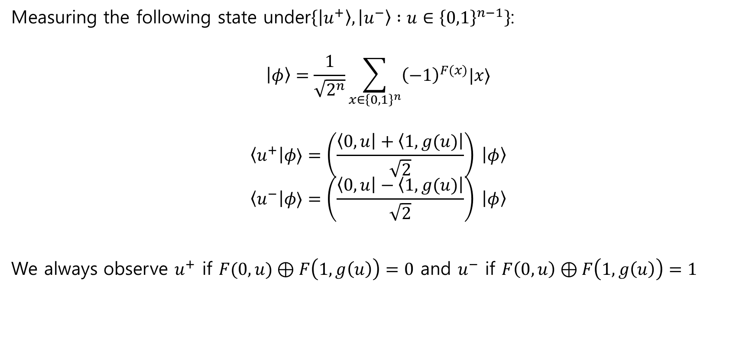
Example: Hidden matching problem
Slightly advanced
Measuring the following state under$\left\{\left|u^{+}\right\rangle ,\left|u^{−}\right\rangle :u∈{\left\{0,1\right\}}^{n−1}\right\}$:
$$\left|φ\right\rangle =\frac{1}{\sqrt{2^{n}}}\sum_{x∈{\left\{0,1\right\}}^{n}}{{\left(−1\right)}^{F(x)}|x⟩}$$
$$\left\langle u^{+}\right|φ⟩=\left(\frac{\left\langle 0,u\right|+\left\langle 1,g(u)\right|}{\sqrt{2}}\right) \left|φ\right\rangle$$
$$\left\langle u^{−}\right|φ⟩=\left(\frac{\left\langle 0,u\right|−\left\langle 1,g(u)\right|}{\sqrt{2}}\right) \left|φ\right\rangle$$
We always observe $u^{+}$ if $F(0,u)⊕F\left(1,g\left(u\right)\right)=0$ and $u^{−}$ if $F\left(0,u\right)⊕F\left(1,g\left(u\right)\right)=1$

Slide 19
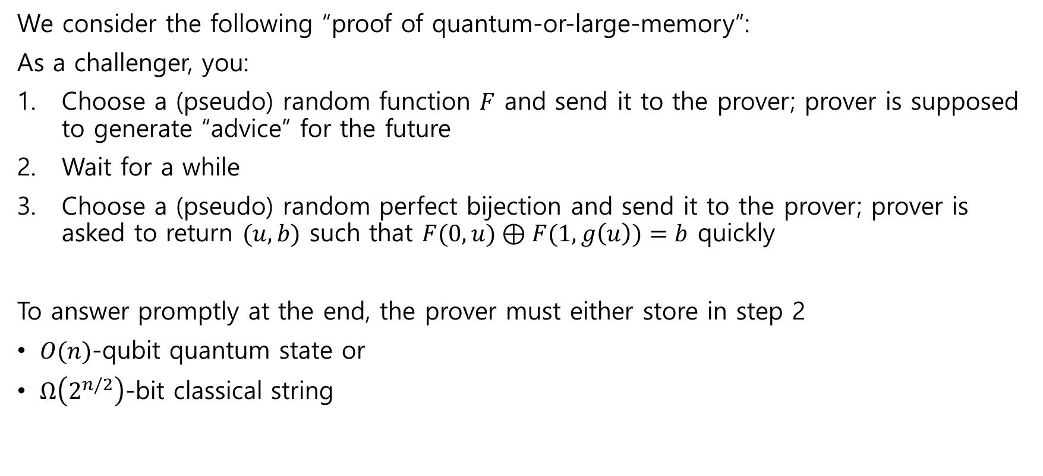
Quantum information supremacy experiment
advanced
We consider the following “proof of quantum-or-large-memory”:
As a challenger, you:
Choose a (pseudo) random function $F$ and send it to the prover; prover is supposed to generate “advice” for the future
Wait for a while
Choose a (pseudo) random perfect bijection and send it to the prover; prover is asked to return $(u,b)$ such that $F(0,u)⊕F(1,g\left(u\right))=b$ quickly
To answer promptly at the end, the prover must either store in step 2
$O(n)$-qubit quantum state or
$Ω\left(2^{n/2}\right)$-bit classical string

